Slide 1
AZ ECAP DB ORACLE
Oracle Database 12c Multitenant Architecture
Prasanna Radhakrishnan
29-Feb-2016

Slide 2
Objective
Help you to get successfully started with Oracle Multitenant

Slide 3
Agenda
Oracle Multitenant Database Architecture
Overview of Multitenant : (CDB) & (PDB)
Multitenant : Create and Configure a (CDB) & (PDB)
Multitenant : Startup and Shutdown (CDB) & (PDB)
Multitenant : Manage Users and Privileges

Slide 4
Oracle Multitenant Database Architecture
Oracle Database 12c offers a new option called Oracle Multitenant that enables to do just that. It offers simplified consolidation that requires no changes to your applications.
Main database contains oracle metadata of all tenant database.
All tenant databases contain user data.
Single instance would be shared by all tenant databases.
Main database called as CDB(container database)
Tenant database called as PDB(pluggable database)
Shared SGA and PGA
Single set of background processes
Let's see how the benefits of Oracle Multitenant stack up against your current database architecture

Slide 5

Oracle Multitenant Database Architecture

Slide 6
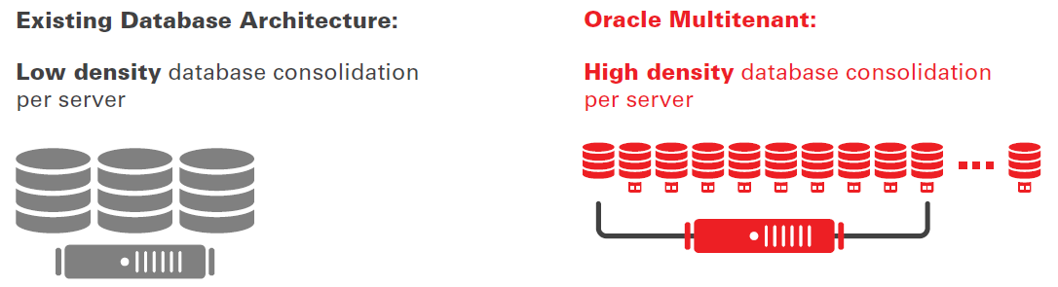
Oracle Multitenant Database Architecture
INCREASE SERVER UTILIZATION

Slide 7
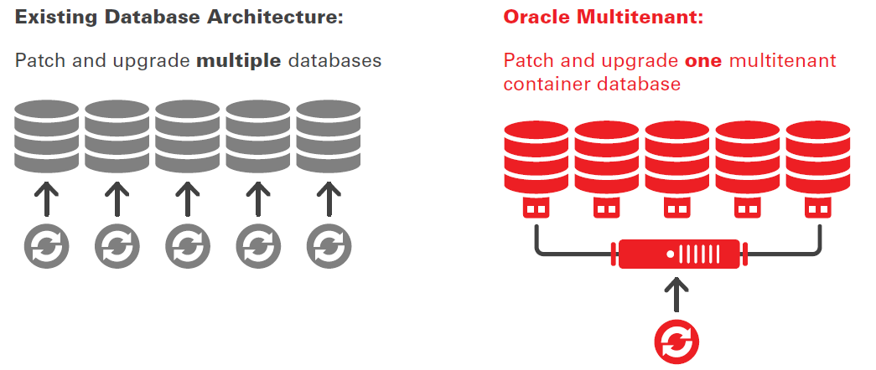
Oracle Multitenant Database Architecture
MANAGE MANY DATABASES AS ONE

Slide 8
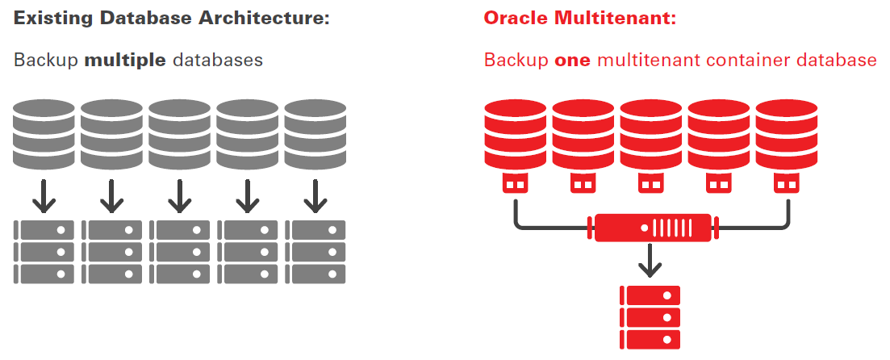
Oracle Multitenant Database Architecture
BACKUP MANY DATABASES AS ONE

Slide 9
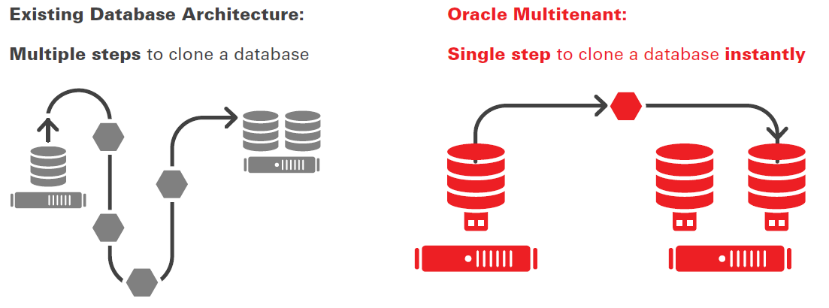
Oracle Multitenant Database Architecture
PROVISION DATABASES RAPIDLY

Slide 10
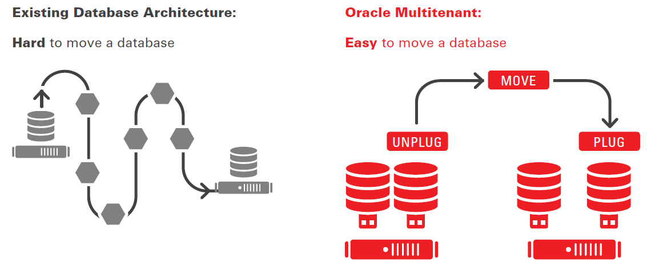
Oracle Multitenant Database Architecture
MOVE DATABASES RAPIDLY

Slide 11
Agenda
Oracle Multitenant Database Architecture
Overview of Multitenant : (CDB) & (PDB)
Multitenant : Create and Configure a (CDB) & (PDB)
Multitenant : Startup and Shutdown (CDB) & (PDB)
Multitenant : Manage Users and Privileges
Multitenant :Cloning pluggable database
Multitenant : Backup and Recovery (CDB) & (PDB)
Multitenant : Migrate a (Non-CDB) to a (PDB)

Slide 12
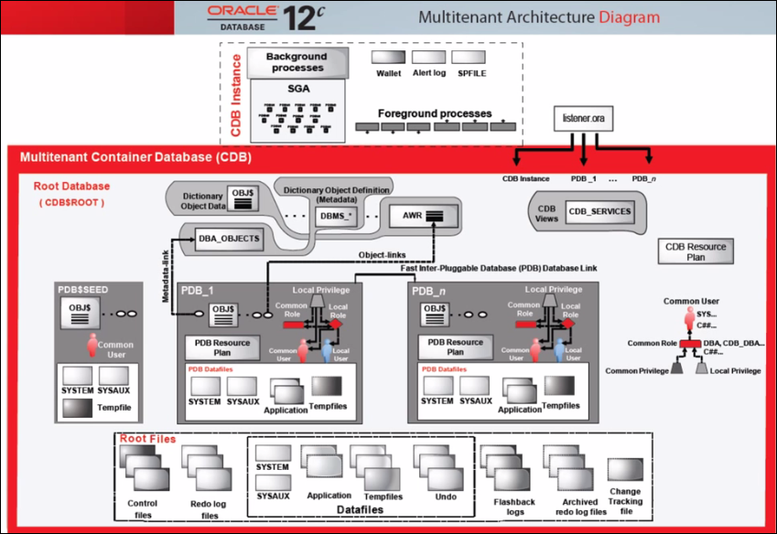
Overview of Multitenant : (CDB) & (PDB)

Slide 13
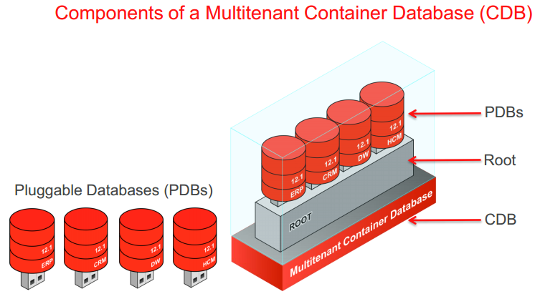
Overview of Multitenant : (CDB) & (PDB)

Slide 14
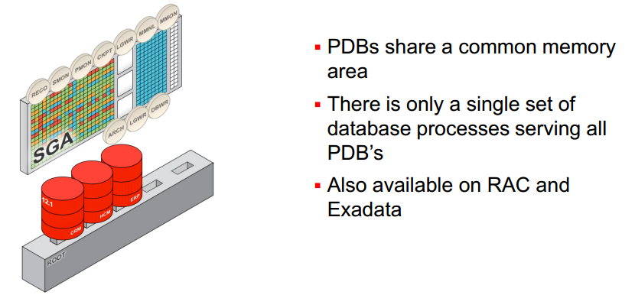
Overview of Multitenant : (CDB) & (PDB)

Slide 15
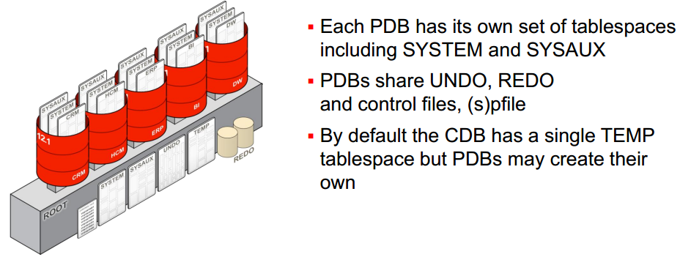
Overview of Multitenant : (CDB) & (PDB)

Slide 16
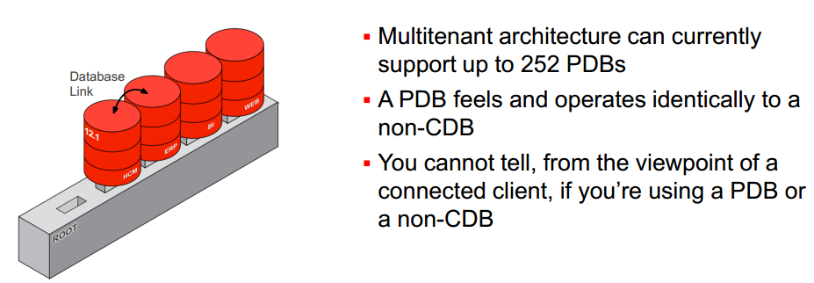
Overview of Multitenant : (CDB) & (PDB)

Slide 17
Agenda
Oracle Multitenant Database Architecture
Overview of Multitenant : (CDB) & (PDB)
Multitenant : Create and Configure a (CDB) & (PDB)
Multitenant : Startup and Shutdown (CDB) & (PDB)
Multitenant : Manage Users and Privileges

Slide 18
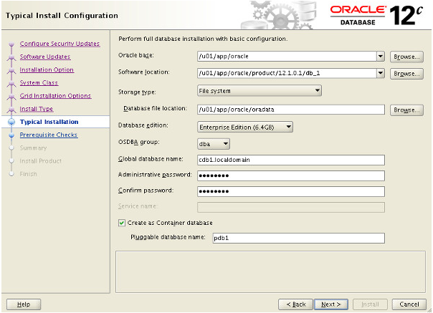
Create and Configure a (CDB) & (PDB) Databases
Oracle Universal Installer (OUI)

Slide 19
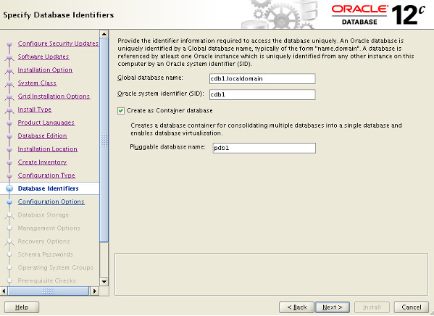
Create and Configure a (CDB) & (PDB) Databases
Advanced configuration options(OUI)

Slide 20
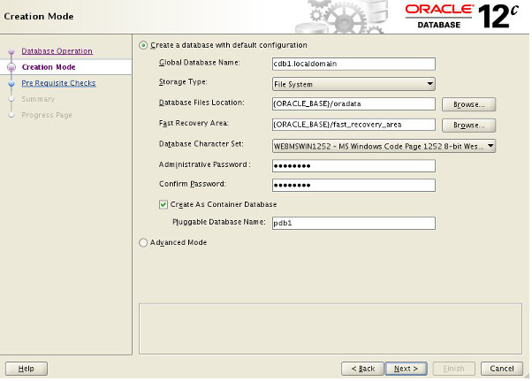
Create and Configure a (CDB) & (PDB) Databases
Database Configuration Assistant (DBCA)

Slide 21
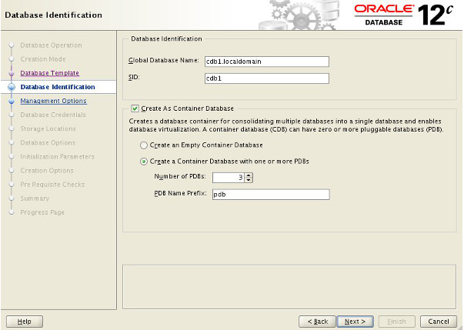
Create and Configure a (CDB) & (PDB) Databases
Database Configuration Assistant (DBCA)

Slide 22
Create and Configure a (CDB) & (PDB) Databases
Manual Creation
Creating CDB using CREATE DATABASE
The CREATE DATABASE command is almost the same
ENABLE PLUGGABLE DATABASE clause must be used
SEED FILE_NAME_CONVERT clause (only if not using OMF)
DB_CREATE_FILE_DEST initialization parameter if using OMF
or
PDB_FILE_NAME_CONVERT initialization parameter

Slide 23
Create and Configure a (CDB) & (PDB) Databases
CREATE DATABASE without OMF
SQL> CREATE DATABASE acdb
USER SYS IDENTIFIED BY ORACLE
USER SYSTEM IDENTIFIED BY ORACLE
….
ENABLE PLUGGABLE DATABASE SEED FILE_NAME_CONVERT = ('/u01/app/oracle/oradata/acdb/', '/u01/app/oracle/oradata/pdbseed/') SYSTEM DATAFILES SIZE 300M AUTOEXTEND ON NEXT 10M MAXSIZE UNLIMITED SYSAUX DATAFILES SIZE 200M USER_DATA TABLESPACE usertbs DATAFILE '/u01/app/oracle/oradata/pdbseed/usertbs01.dbf' SIZE 200M REUSE AUTOEXTEND ON MAXSIZE UNLIMITED;
SQL> @?/rdbms/admin/catcdb.sql

Slide 24
Create and Configure a (CDB) & (PDB) Databases
CREATE DATABASE with OMF
SQL> CREATE DATABASE acdb
USER SYS IDENTIFIED BY ORCL
USER SYSTEM IDENTIFIED BY ORCL
EXTENT MANAGEMENT LOCAL
DEFAULT TABLESPACE users
DEFAULT TEMPORARY TABLESPACE temp
UNDO TABLESPACE undotbs1
ENABLE PLUGGABLE DATABASE
SEED
SYSTEM DATAFILES SIZE 300M AUTOEXTEND ON NEXT 10M MAXSIZE UNLIMITED SYSAUX DATAFILES SIZE 200M;
SQL> @?/rdbms/admin/catcdb.sql*

Slide 25
Create and Configure a (CDB) & (PDB) Databases
Data Dictionary Changes
CDB_*
–Dictionary views showing data from Root and all Pluggable databases
DBA_*
−Dictionary views showing data from a container or from Pluggable databases
ALL_*
–Dictionary views showing data accessible by a users
USER_*
−Dictionary views showing data owned by a user
SELECT table_name FROM dict WHERE table_name like 'DBA%';
SELECT view_name FROM dba_views WHERE view_name like 'CDB%';

Slide 26
Agenda
Oracle Multitenant Database Architecture
Overview of Multitenant : (CDB) & (PDB)
Multitenant : Create and Configure a (CDB) & (PDB)
Multitenant : Startup and Shutdown (CDB) & (PDB)
Multitenant : Manage Users and Privileges

Slide 27
Startup and Shutdown (CDB) & (PDB)
Container Database (CDB)
STARTUP [NOMOUNT | MOUNT | RESTRICT | UPGRADE | FORCE | READ ONLY]
SHUTDOWN [IMMEDIATE | ABORT]
Pluggable Database (PDB)
STARTUP FORCE;
STARTUP OPEN READ WRITE [RESTRICT];
STARTUP OPEN READ ONLY [RESTRICT];
STARTUP UPGRADE;
SHUTDOWN [IMMEDIATE];

Slide 28
Startup and Shutdown (CDB) & (PDB)
ALTER PLUGGABLE DATABASE
ALTER PLUGGABLE DATABASE OPEN READ WRITE [RESTRICTED] [FORCE];
ALTER PLUGGABLE DATABASE OPEN READ ONLY [RESTRICTED] [FORCE];
ALTER PLUGGABLE DATABASE OPEN UPGRADE [RESTRICTED];
ALTER PLUGGABLE DATABASE CLOSE [IMMEDIATE];
Some examples of open using Alter Command:
alter pluggable database azpdb1 open;
alter pluggable database azpdb1 open read only;
alter pluggable database azpdb1 open read write;
alter pluggable database azpdb1,azpdb2 open immediate;
alter pluggable database all open read write;
alter pluggable database all except azpdb1 open read write;
alter pluggable database all except azpdb1 open read write force;
alter pluggable database all except azpdb1 open resetlogs;
alter pluggable database azpdb1 open restricted;
startup

Slide 29
Startup and Shutdown (CDB) & (PDB)
ALTER PLUGGABLE DATABASE
Some examples of close using Alter Command:
alter pluggable database azpdb1 close;
alter pluggable database azpdb1 close immediate;
alter pluggable database azpdb1,azpdb2 close immediate;
alter pluggable database all close immediate;
alter pluggable database all except azpdb1 close immediate;
shutdown immediate
Pluggable Database (PDB) Automatic Startup
CREATE OR REPLACE TRIGGER open_pdbs
AFTER STARTUP ON DATABASE BEGIN EXECUTE IMMEDIATE 'ALTER PLUGGABLE DATABASE ALL OPEN';
END open_pdbs;
/

Slide 30
Startup and Shutdown (CDB) & (PDB)
Data Dictionary and Dynamic Performance Tables to check the status
SELECT NAME, CDB, CON_ID FROM V$DATABASE;
select instance_name, version, status, con_id from v$instance;
COL PDB_NAME FOR A30
SELECT PDB_ID,PDB_NAME,STATUS,CON_ID FROM CDB_PDBS;
select NAME,OPEN_MODE,CON_ID from v$pdbs;
COL PDB_NAME FOR A30
select b.con_id,a.pdb_name,a.status,b.open_mode
from dba_pdbs a, v$pdbs b
where a.pdb_name= b.name
order by b.con_id;

Slide 31
Agenda
Oracle Multitenant Database Architecture
Overview of Multitenant : (CDB) & (PDB)
Multitenant : Create and Configure a (CDB) & (PDB)
Multitenant : Startup and Shutdown (CDB) & (PDB)
Multitenant : Manage Users and Privileges

Slide 32
Manage Users and Privileges
When connected to a multitenant database the management of users and privileges is a little different to traditional Oracle environments. In multitenant environments there are two types of user.
Common User : The user is present in all containers (root and all PDBs).
Local User : The user is only present in a specific PDB. The same username can be present in multiple PDBs, but they are unrelated.
Likewise, there are two types of roles.
Common Role : The role is present in all containers (root and all PDBs).
Local Role : The role is only present in a specific PDB. The same role name can be used in multiple PDBs, but they are unrelated.

Slide 33
Manage Users and Privileges
Create Common Users
CONN / AS SYSDBA
-- Create the common user using the CONTAINER clause.
CREATE USER c##test_user1 IDENTIFIED BY password1 CONTAINER=ALL;
GRANT CREATE SESSION TO c##test_user1 CONTAINER=ALL;
-- Create the common user using the default CONTAINER setting.
CREATE USER c##test_user2 IDENTIFIED BY password1;
GRANT CREATE SESSION TO c##test_user2;

Slide 34
Manage Users and Privileges
Create Local Users
CONN / AS SYSDBA
-- Switch container while connected to a common user.
ALTER SESSION SET CONTAINER = pdb1;
-- Create the local user using the CONTAINER clause.
CREATE USER test_user3 IDENTIFIED BY password1 CONTAINER=CURRENT;
GRANT CREATE SESSION TO test_user3 CONTAINER=CURRENT;
-- Connect to a privileged user in the PDB.
CONN system/password@pdb1
-- Create the local user using the default CONTAINER setting.
CREATE USER test_user4 IDENTIFIED BY password1;
GRANT CREATE SESSION TO test_user4;

Slide 35
Manage Users and Privileges
Create Common Roles
CONN / AS SYSDBA
-- Create the common role.
CREATE ROLE c##test_role1;
GRANT CREATE SESSION TO c##test_role1;
-- Grant it to a common user.
GRANT c##test_role1 TO c##test_user1 CONTAINER=ALL;
--Grant it to a local user.
ALTER SESSION SET CONTAINER = pdb1;
GRANT c##test_role1 TO test_user3;

Slide 36
Manage Users and Privileges
Create Local Roles
CONN / AS SYSDBA
-- Switch container.
ALTER SESSION SET CONTAINER = pdb1;
-- Alternatively, connect to a local or common user -- with the PDB service.
-- CONN system/password@pdb1
-- Create the common role.
CREATE ROLE test_role1;
GRANT CREATE SESSION TO test_role1;

